Slide 1

Physical activity prediction From Wearable sensors
Dominic Arcona
Advisor: Larry Goldstein
December, 1, 2023

Slide 2

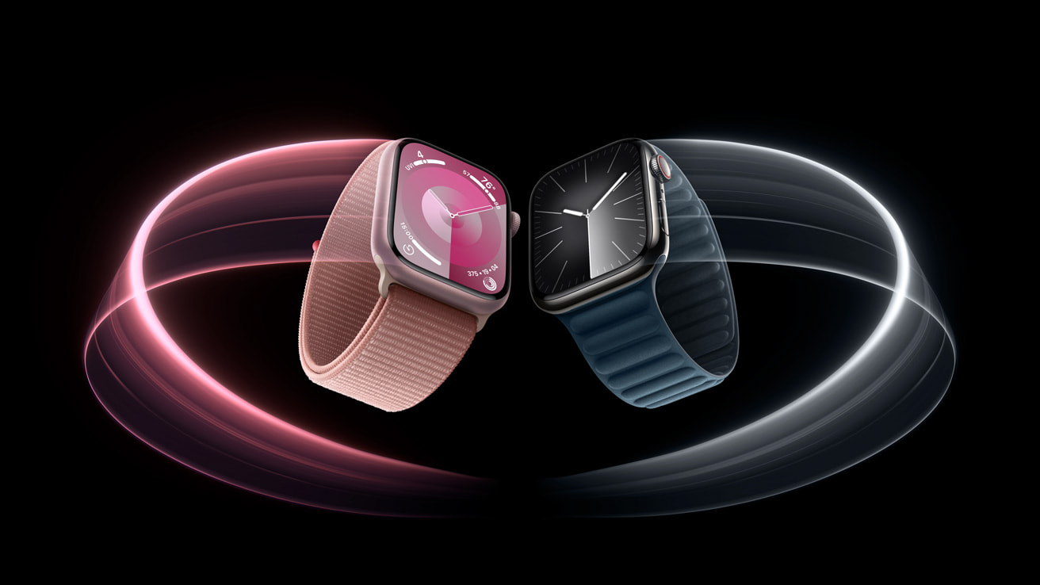
problem statement
Global wearable sensors market size estimated at $1.6B USD in 2023 [1].
Wearable sensors such as Apple Watch, Fitbit, WHOOP, and Oura can collect data such as heart rate, skin temperature, GPS location, blood oxygen concentration, and acceleration several times per second.
Application to Health and Fitness – Users want to track their daily activities and learn how they impact their immediate and long-term health.
Can we predict what activity is being performed based on data collectable from a wearable sensor? How accurate can our predictions be?

Slide 3
Data overview
Original data sourced from UCI Machine Learning Repository.
Data was cleaned and uploaded to Kaggle by Diego Silva [2].
Data includes 2,864,056 observations from 8 study participants each wearing sensors on their wrist, ankle, and chest.
Study participants each performed a number of physical activities while data was sampled rapidly (~100x per second) via their wearable sensors.
There are 31 predictors, 1 response variable (activityID), and 1 additional variable (PeopleId).

Slide 4
Data overview - response variable
Activity | % of Observations
Transient Activity | 32.3
Ascending Stairs | 4.1
Descending Stairs | 3.7
Cycling | 5.7
Running | 3.4
Walking | 8.3
Sitting | 6.5
Standing | 6.6
Lying | 6.7
Nordic Walking | 6.6
Ironing | 8.3
Vacuum Cleaning | 6.1
Rope Jumping | 1.5
activityID takes 13 unique values
Transient Activity is by far the most common activity present
We will attempt to classify observations into one of these 13 classes

Slide 5
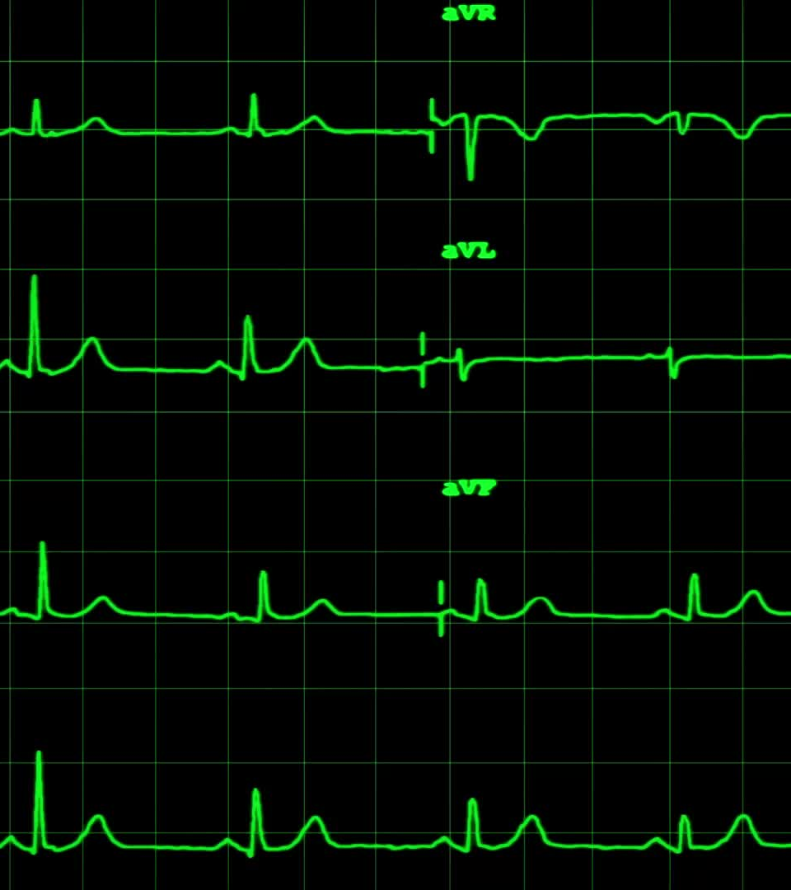
Data overview - predictors
31 Predictors are available:
heart_rate
At each of hand, ankle, and chest, we have:
Gyration (X,Y,Z), acceleration (X,Y,Z), magnetometer (X,Y,Z), temperature
42 heart_rate values are missing. We use linear interpolation function na.approx() to fill these with negligible impact (42/2,864,056 = 0.000015)

Slide 6
objectives
Accurately predict which activity a wearer is performing based on the predictors available
Evaluate and compare classification models in the context of the multiclass classification problem at hand
Discuss sensible validation schemes in the context of this specific application
Answer consumer questions such as “Where should I wear my sensor for most accurate activity prediction?”
Identify future areas for further exploration

Slide 7
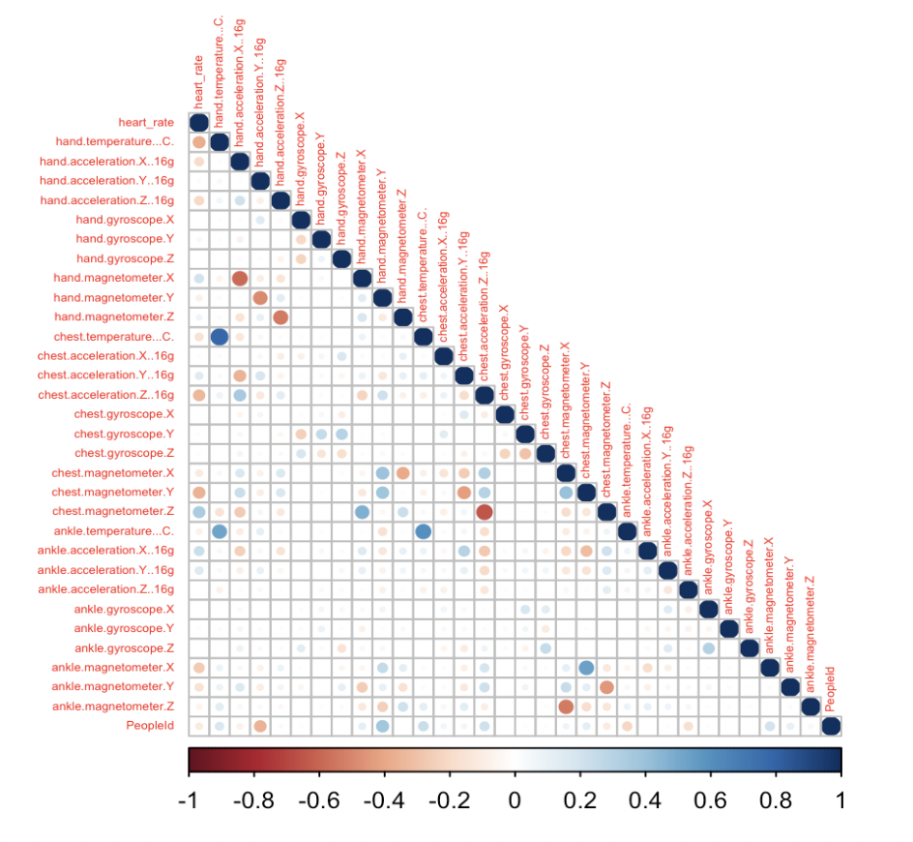
Data preprocessing - correlation plot
The correlation plot can inform our feature engineering process
Skin temperature variables are highly correlated
Magnetometer and acceleration are negatively correlated at the same body part and direction

Slide 8

Data preprocessing - feature engineering
Standardize heart_rate:
scaled_hr = heart_rate / max_hr (max_hr is calculated individually for each PeopleId)
Combine temperature readings into a single body temperature variable:
body_temp = (chest_temp + ankle_temp + hand_temp)/3
Other ideas (not implemented)
Combine Acceleration and Magnetometer observations (How?)
Alternatively, drop one of these two variables
Magnitude of acceleration, gyration, and magnetometer combining x,y, z observations
Eg. chest_gyr_total = \sqrt{chest_gyr_x^2 + chest_gyr_y^2 + chest_gyr_z^2}

Slide 9
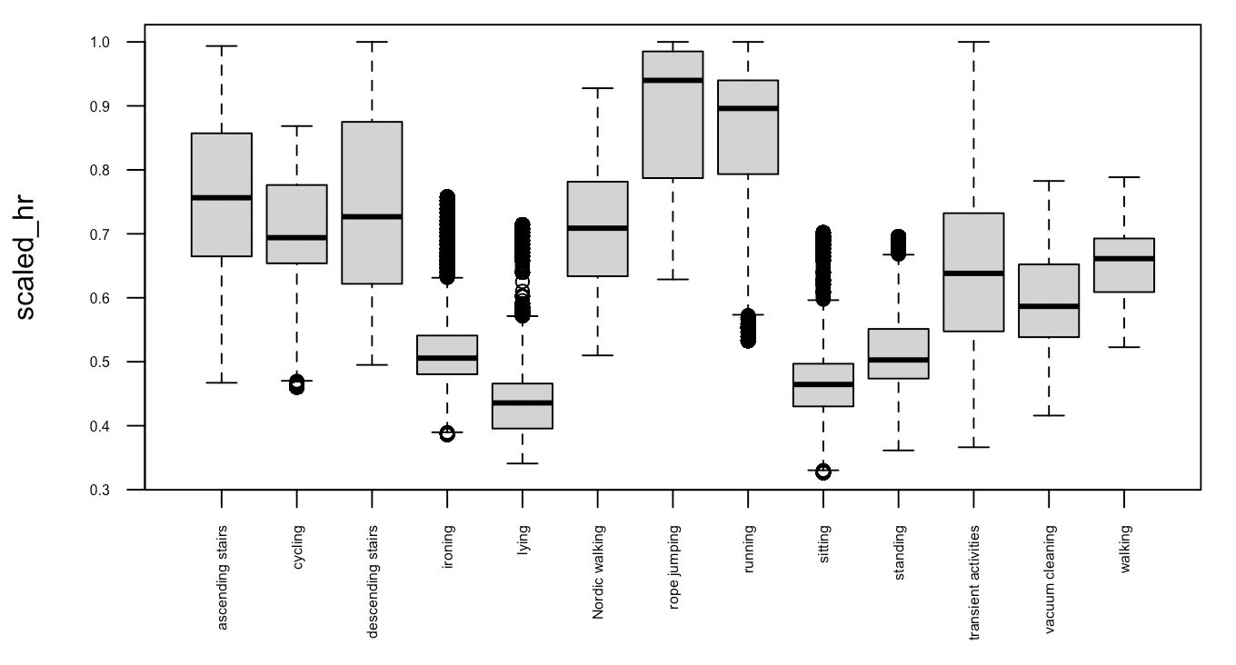
Data preprocessing - boxplots

Slide 10
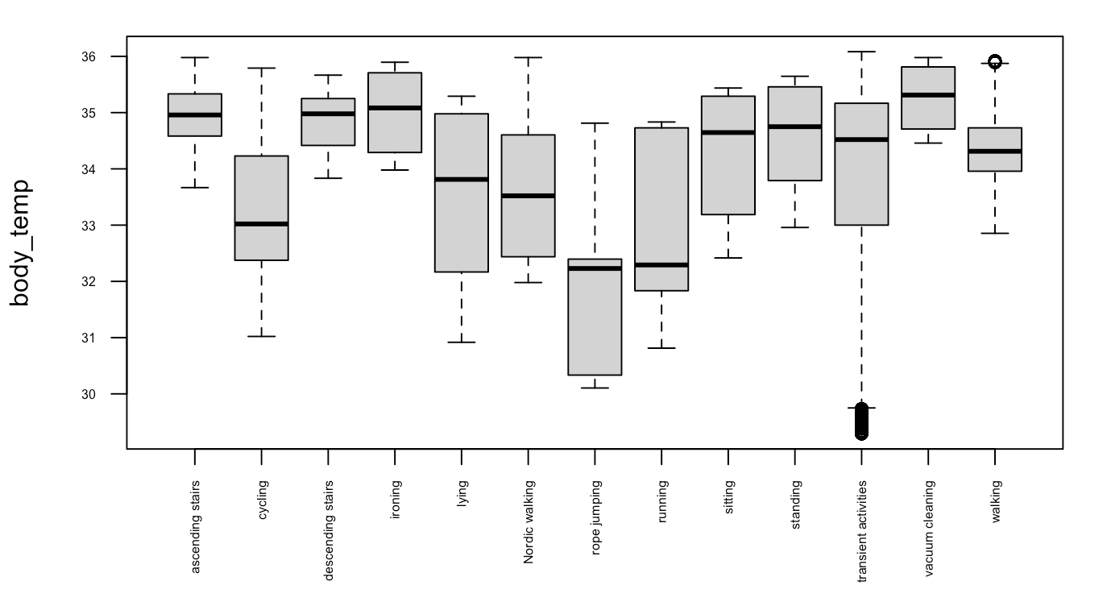
Data preprocessing - boxplots

Slide 11
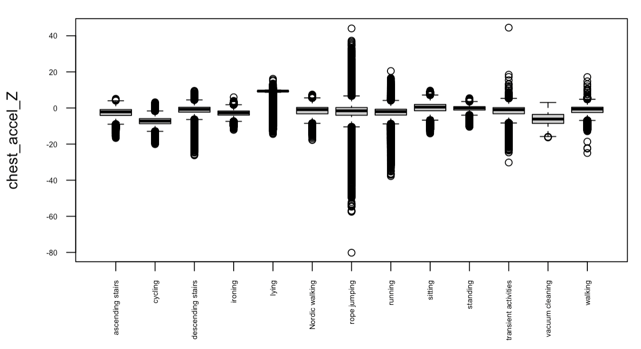
Data preprocessing - boxplots

Slide 12
Model training approach
Multinomial Logistic Regression using multinom()
KNN classifier with k=3 and k=5 using knn()***
Decision Tree classifier using randomForest() with ntree=1
Random Forest classifier using randomForest()
Boosting classifier using gbm()
***Implementation difficulties

Slide 13
Model training approach - train and test sets
Immense amount of data makes model training and testing with all observations impractical
Unbalanced class sizes present a challenge
One option – feed models a vector of class weights
Another option – Create training set in which class weights are artificially balanced
We will try the first option first, feeding each of our classification models a vector of class weights as an input in the model fit function call.
We’ll use a random sample of 200,000 of our observations as a train set, and a random sample of 200,000 of the remaining observations as a test set.

Slide 14
Model comparison
Models will be evaluated based on the confusion matrix and balanced accuracy (average of sensitivity and specificity) for each class
We will pay special attention to the specificity of the transient activities class and the sensitivity of under-represented classes such as running and rope jumping

Slide 15
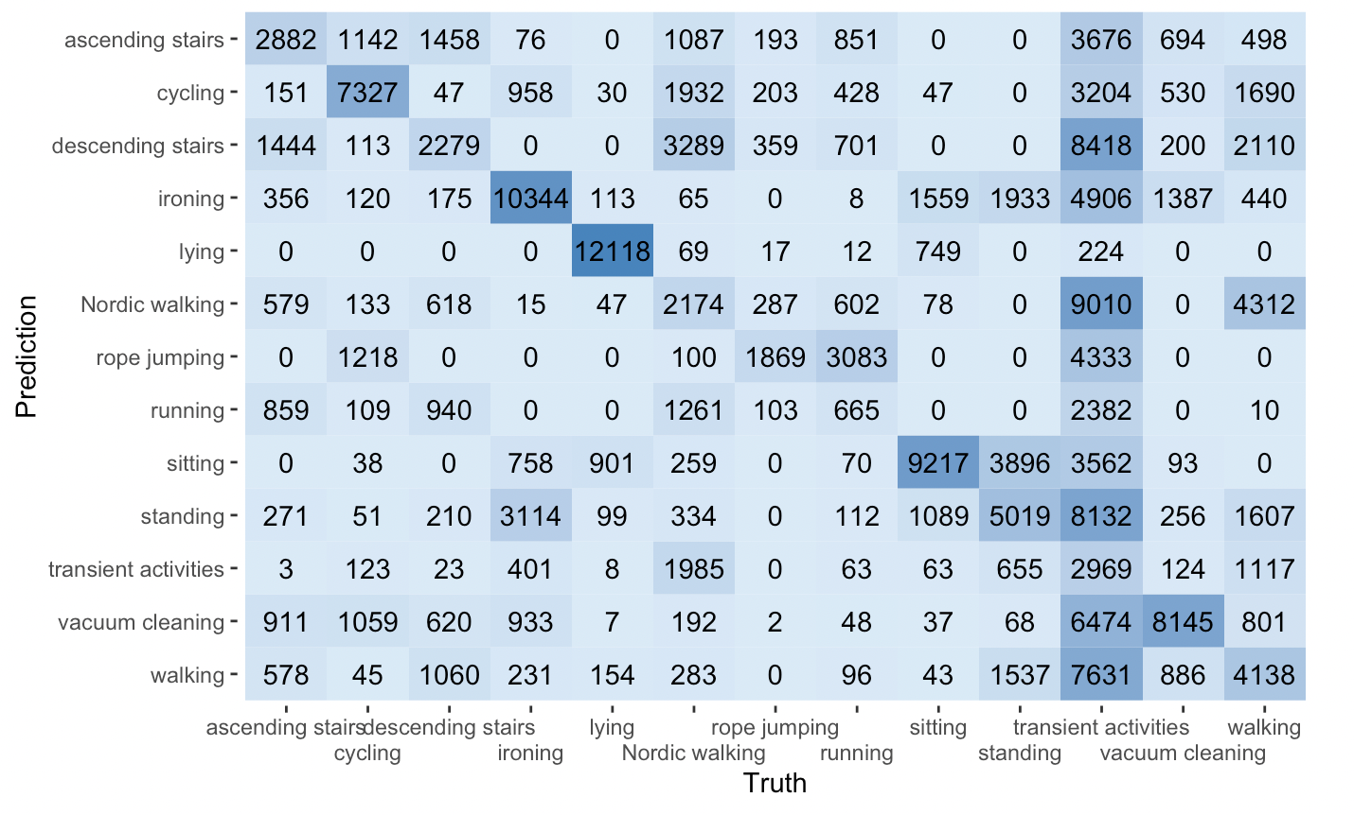
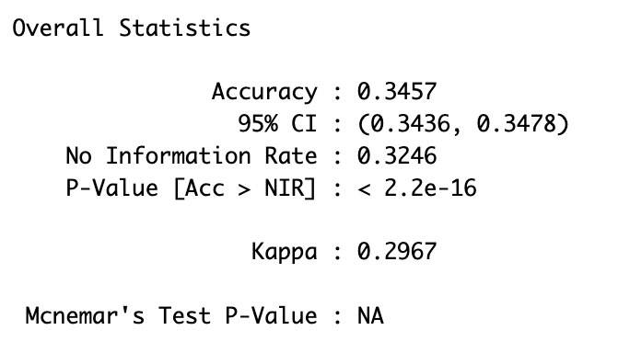
Results - multinomial logistic regression
Call: logit.fit <- multinom(activityID ~ scaled_hr + chest.acceleration.Z..16g + body_temp, data=train, weights = wt_vector)

Slide 16
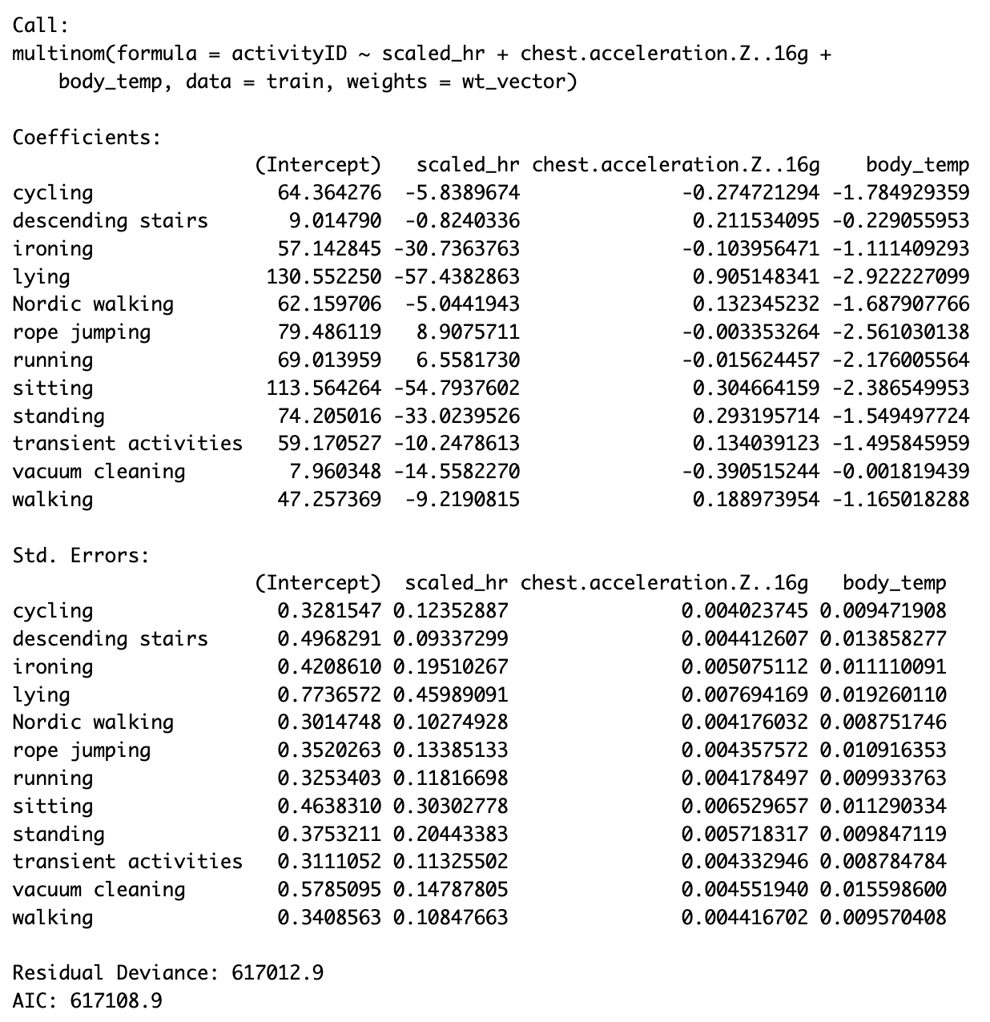
Results - multinomial logistic regression

Slide 17
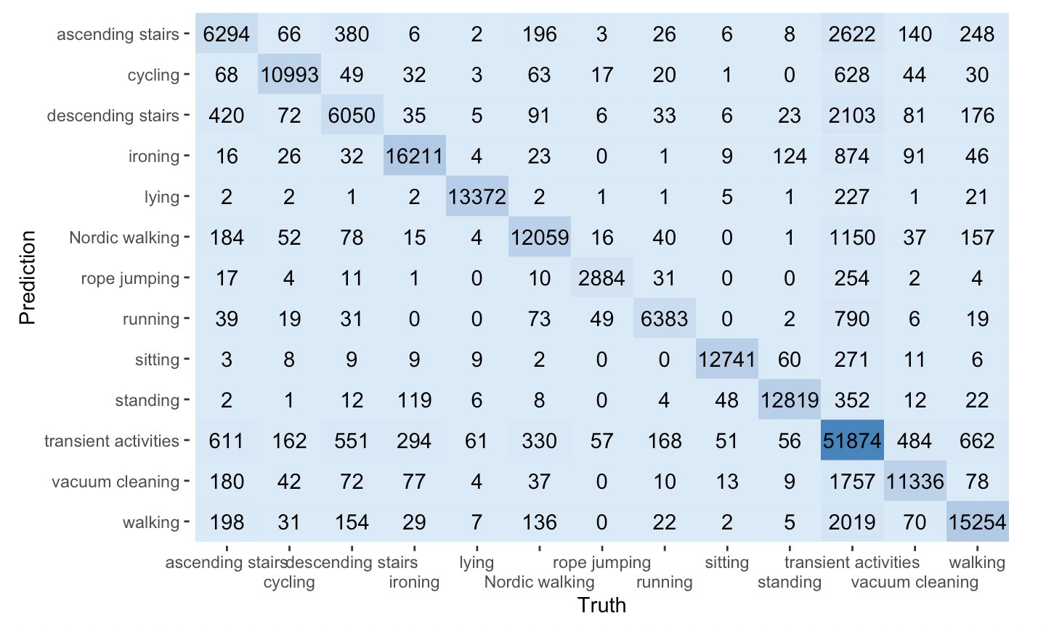
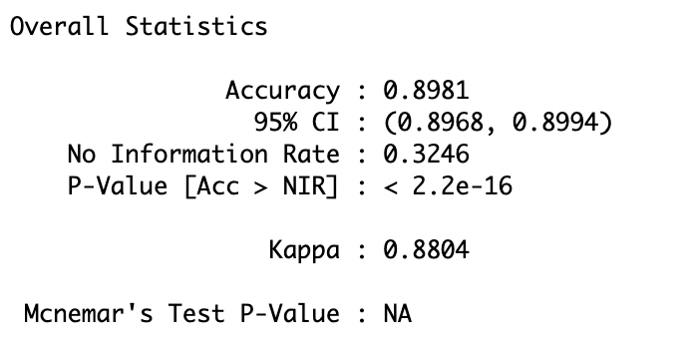
Results - Decision TreE Classifier
Call: tree.pap <- randomForest(activityID ~ ., train, weights = wt_vector, mtry = 31, ntree=1, importance=TRUE)

Slide 18
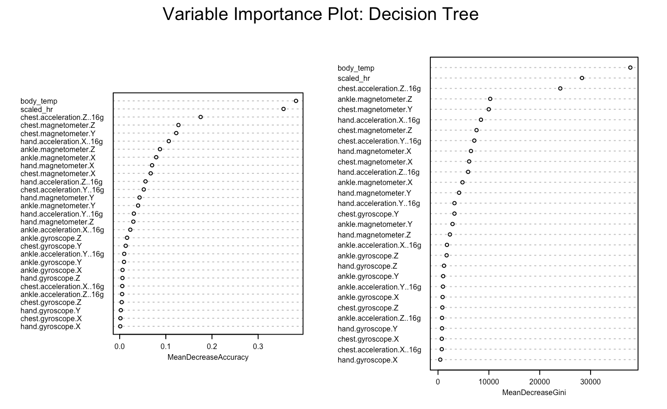

Slide 19
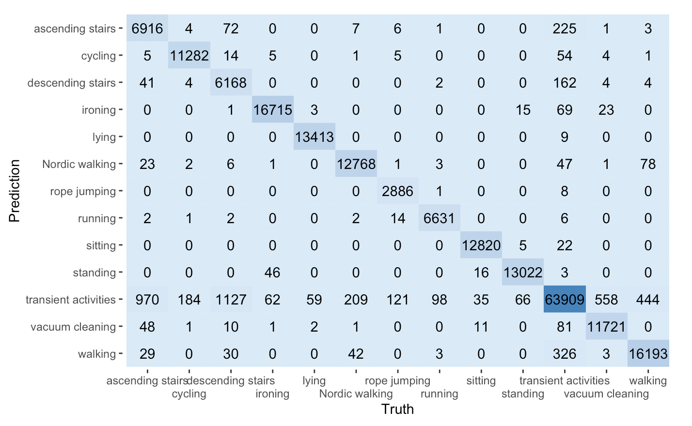
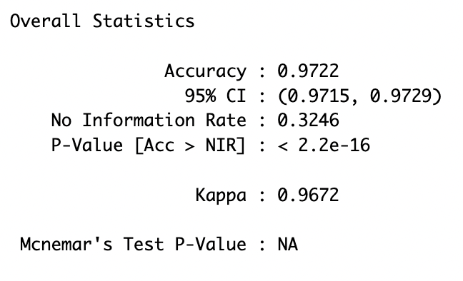
Results - Random Forest Classifier
Call: rf.pap <- randomForest(activityID ~ ., train, weights = wt_vector, ntree=100, importance=TRUE)

Slide 20
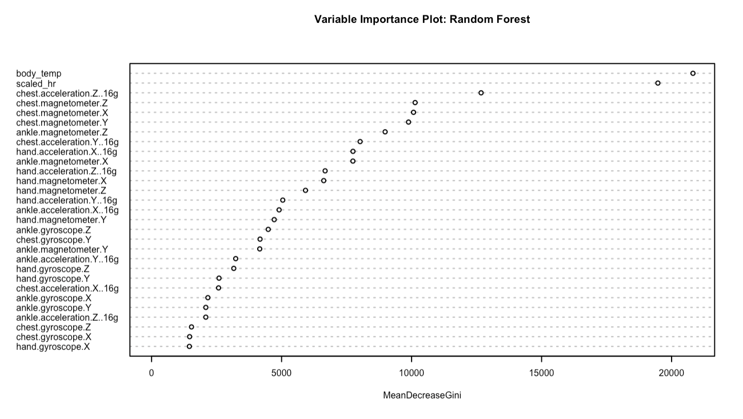

Slide 21
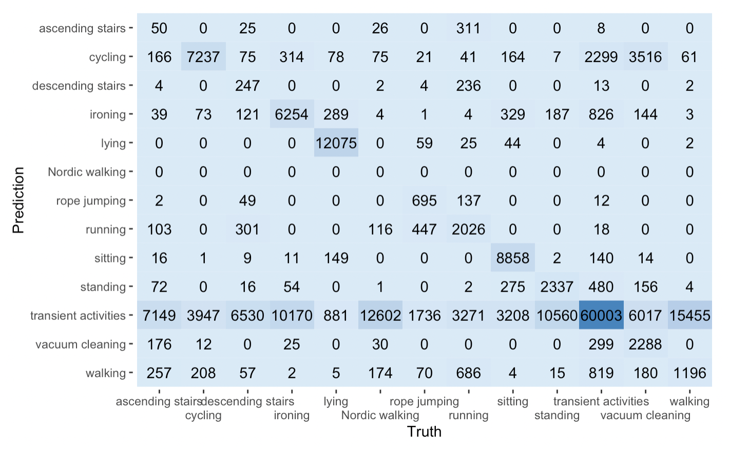
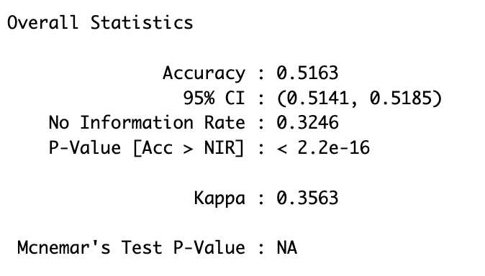
Results - boosting tree Classifier
Call: boost.pap <- gbm(activityID ~., data = train, n.trees=100, interaction.depth=1, shrinkage = .01)

Slide 22
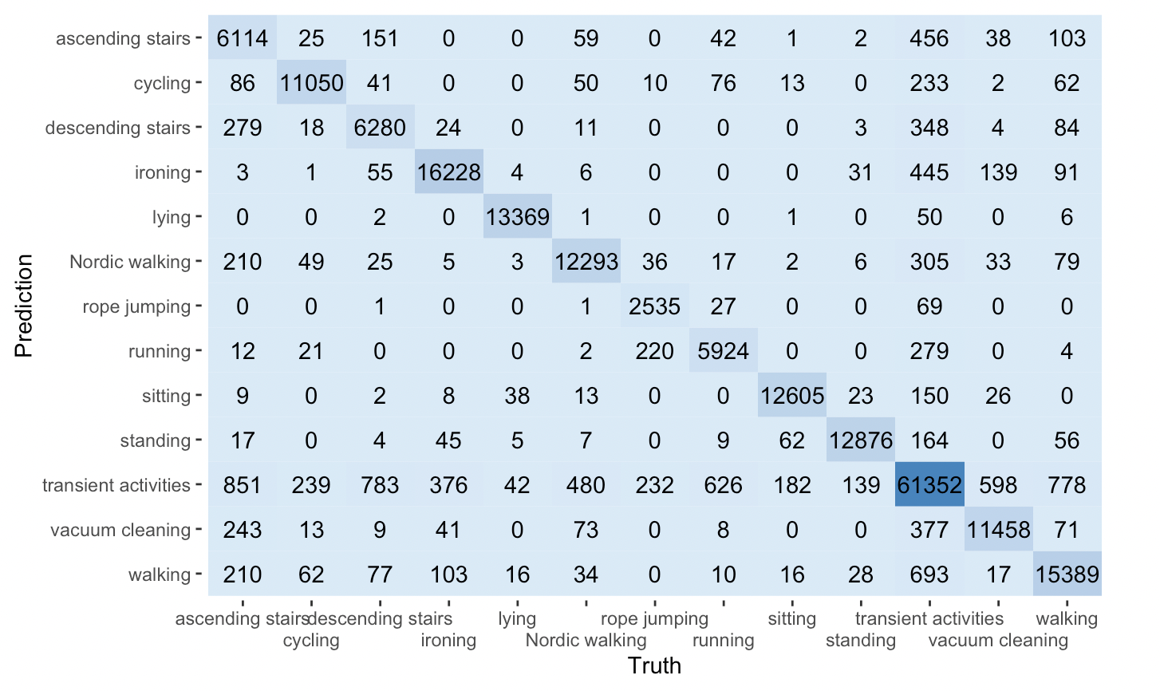
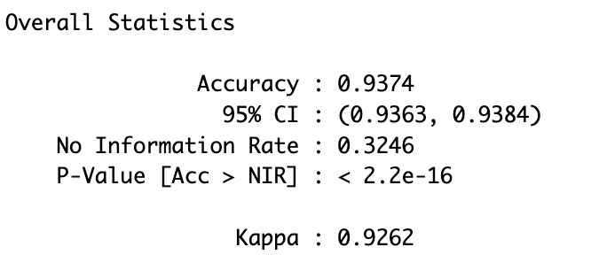
Results - Random Forest Classifier with only 3 predictors
Call: rf.pap <- randomForest(activityID ~ scaled_hr + chest.acceleration.Z..16g + body_temp, train, classwt = class_wts, ntree=100, importance=TRUE)

Slide 23
Results, Limitations, and improvements
The results indicate that the random forest classifier outperforms the others by a wide margin on this dataset.
One caveat to this claim is that we did not invest time in tuning model hyperparameters (such as shrinkage for the boosting model). Runtime was a major difficulty. Tuning the model hyperparameters is one area in which future improvements can be sought out.
Can we increase the accuracy of the random forest classifier using another approach? (Personal experience with WHOOP sets high expectations.)
We will recategorize our response variable in two different ways to try to address this issue.
We also will resample our training data going forward so that our classes are balanced.

Slide 24
New approach a - activity clustering
From our first attempts at modeling the data, we notice that the models have great difficulty handling the 'transient activities' class even when class weights are provided. This class is understood to have high variability in every predictor. What are transient activities anyway? We will proceed with the remainder of our analysis using the following key assumptions:
1) The client is interested in predicting whether an individual wearing their sensor is engaged in deliberate exercise.
2) When an individual is engaged in deliberate exercise, the client is interested in classifying the type of exercise they are engaged in.
With these assumptions in mind, we will re-group our activities in a more sensible way:
1) Deliberate Exercise activities will include cycling, stair climbing (combining ascending and descending stairs), Nordic walking, rope jumping, running, and walking.
2) The 'transient activities' activity will be expanded to include all non-deliberate exercise activities.

Slide 25
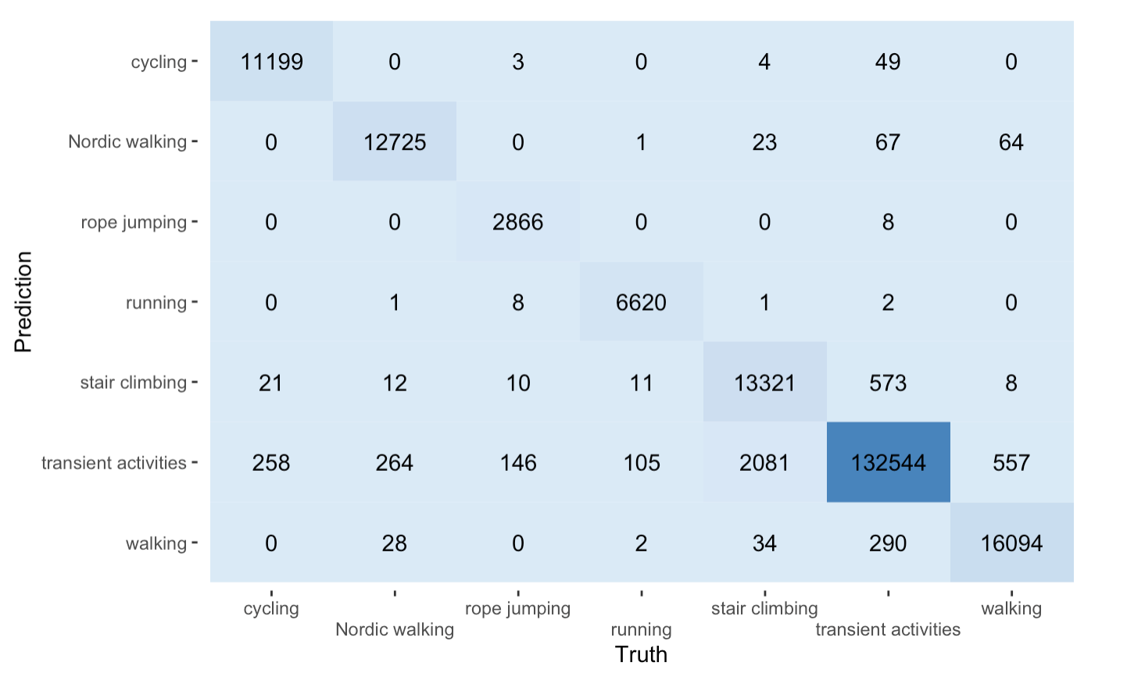
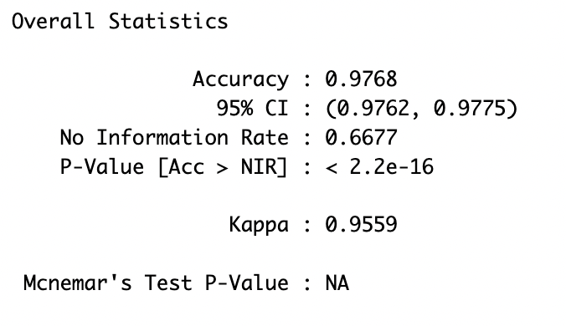
Results - approach a

Slide 26
Results - approach a
The new model makes slight improvements in classification of transient activities and stair climbing (both notably redefined).
This comes at a cost of slightly lower sensitivity for exercise classes such as cycling, Nordic walking, running, and walking

Slide 27
new approach b - exercise prediction
Here we return to binary classification
Goal is to simply predict whether an individual is engaged in deliberate exercise
Only random forest model was attempted given its solid past performance on these data

Slide 28
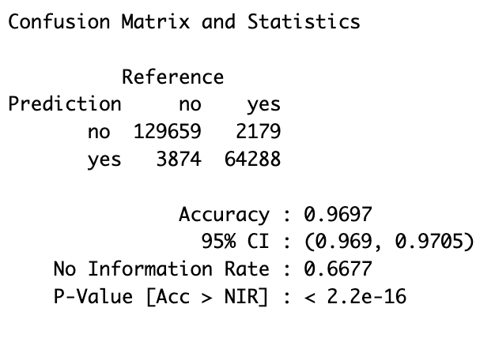
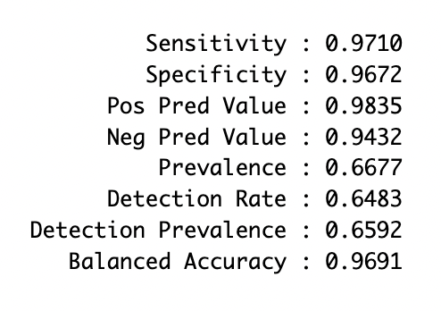
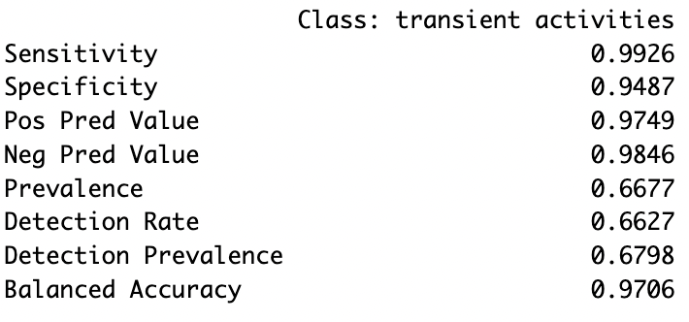
Results - approach B
B
A
No improvement over Approach A!
We do get the added benefit of being able to predict probabilities from this model though

Slide 29
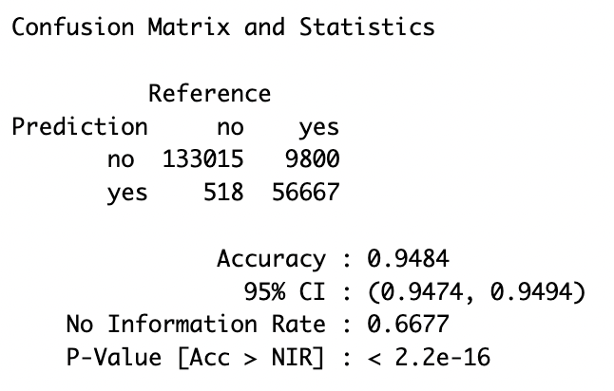
Results - approach B
Top is typical response prediction.
Bottom requires exercise to have probability > 0.7 for positive class prediction.

Slide 30
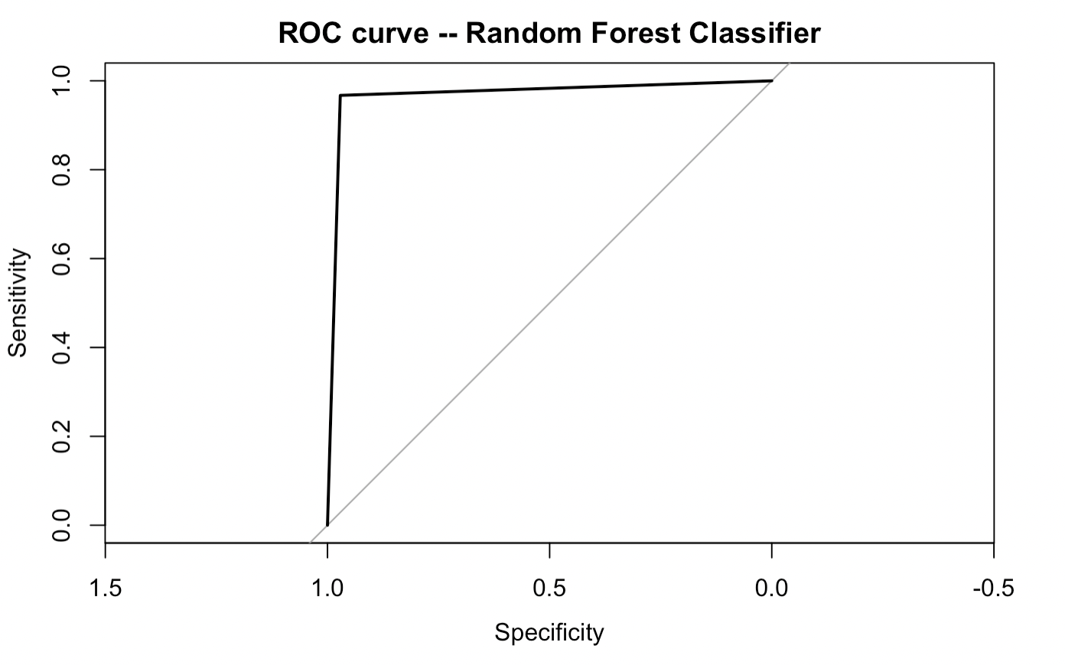
Results - approach B
Area under the curve: 0.9691

Slide 31
For further investigation: combined approach
Combining the ideas from Approaches A and B, we would have a model that first predicts whether an individual is exercising and then, only when the likelihood of exercise is high enough, predicts what exercise is being performed.
Under this approach, the risk of Type I versus Type II error could be adjusted as appropriate in the client’s specific context
Would you rather your device tell you you were exercising when you weren’t? Or that your device not recognize your exercise when you were working out?

Slide 32
Where to wear the sensor? - methodology
In this section, we seek to answer consumer questions the client has received about the best place to wear their sensor – ankle, wrist, or chest?
We will create unique dataframes that use only the data available at these locations and re-train a random forest classifier on each using our approach A in which we have lumped some activities together.
Key assumption: heart_rate is available and identical at all three locations

Slide 33
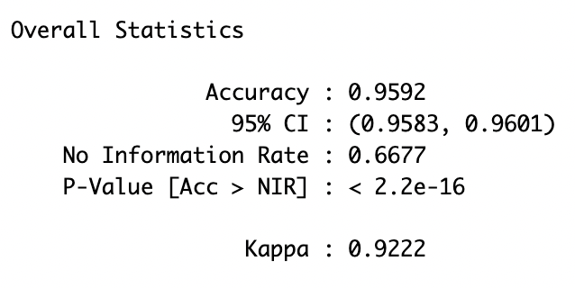
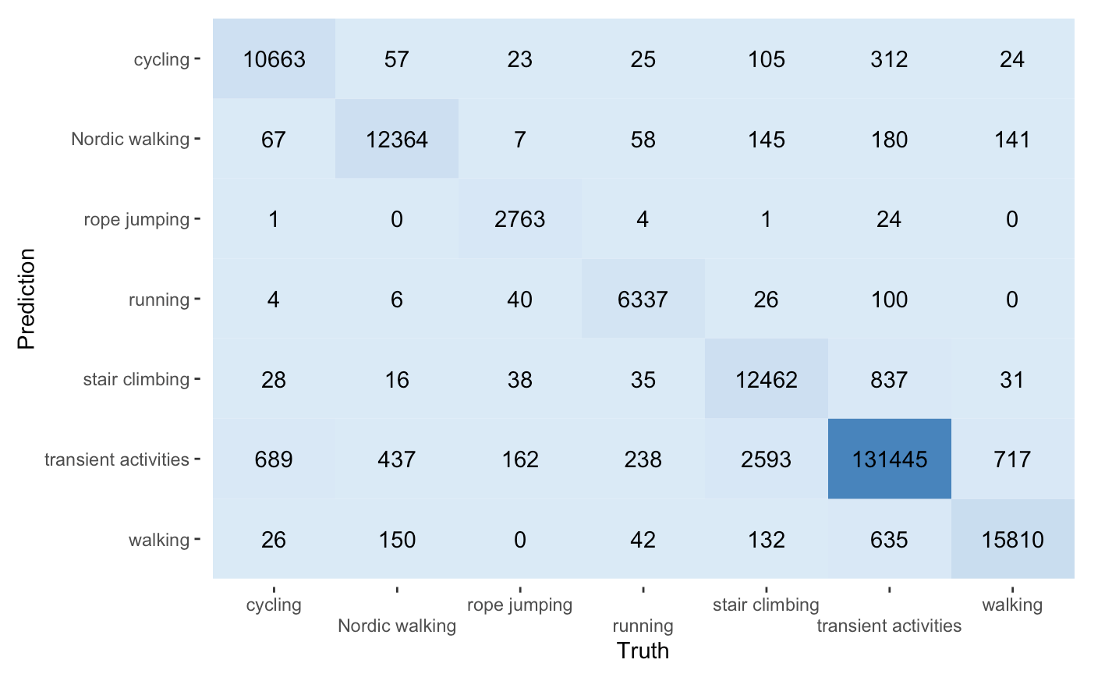
Results - ankle

Slide 34
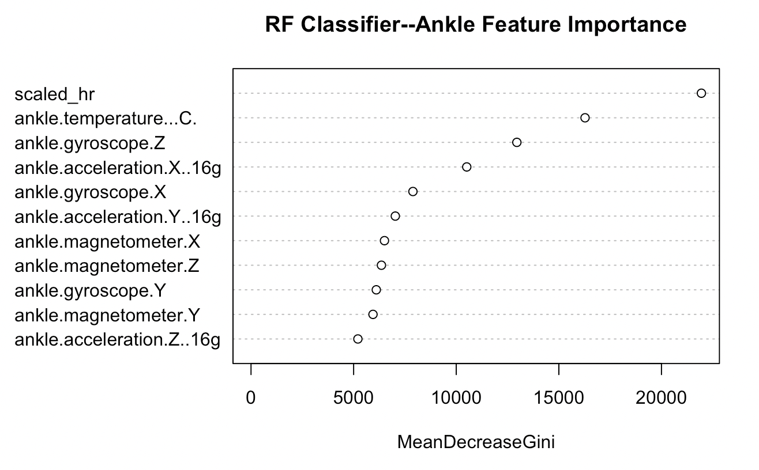

Slide 35
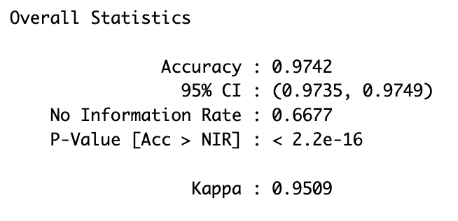

Results - wrist

Slide 36
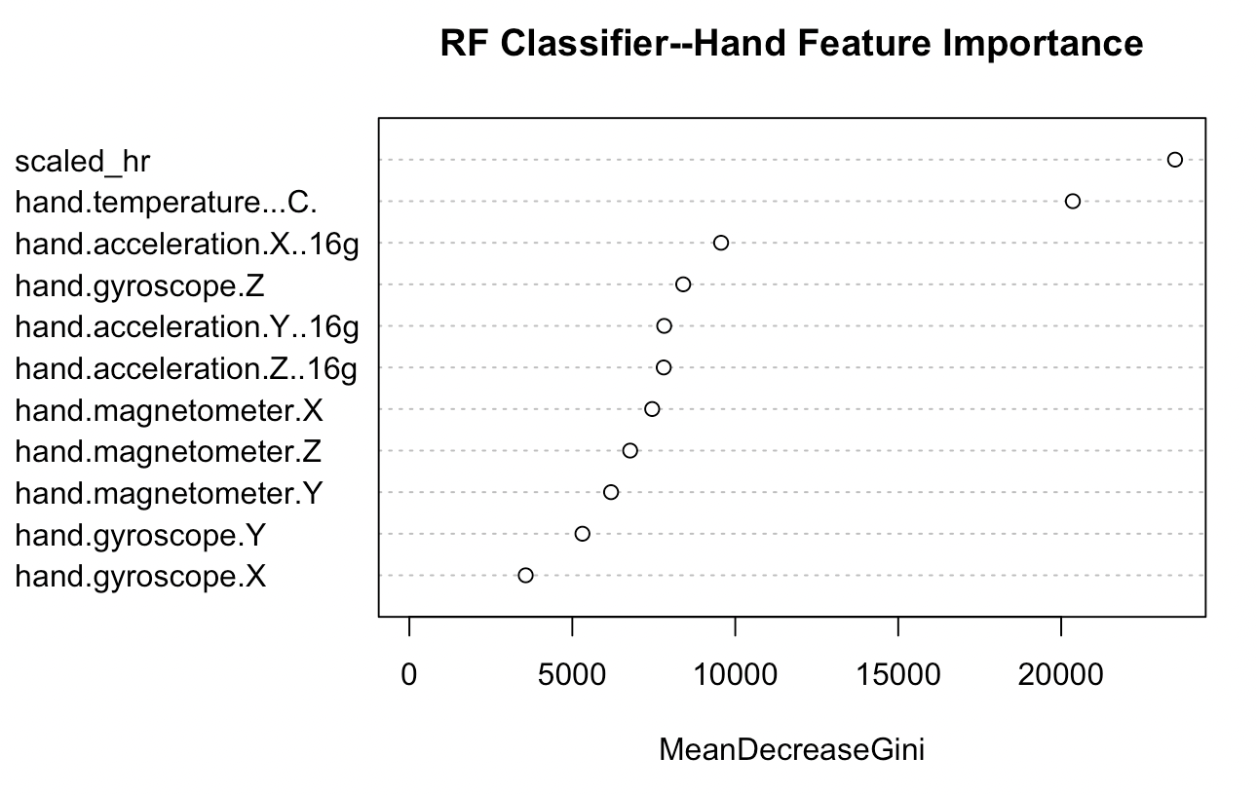

Slide 37
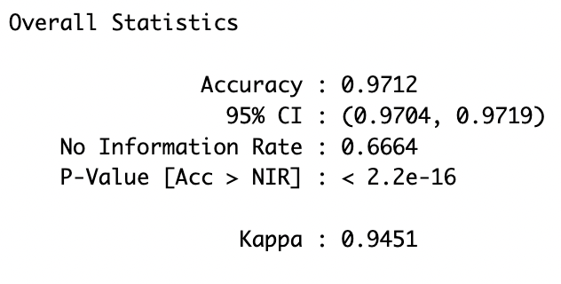
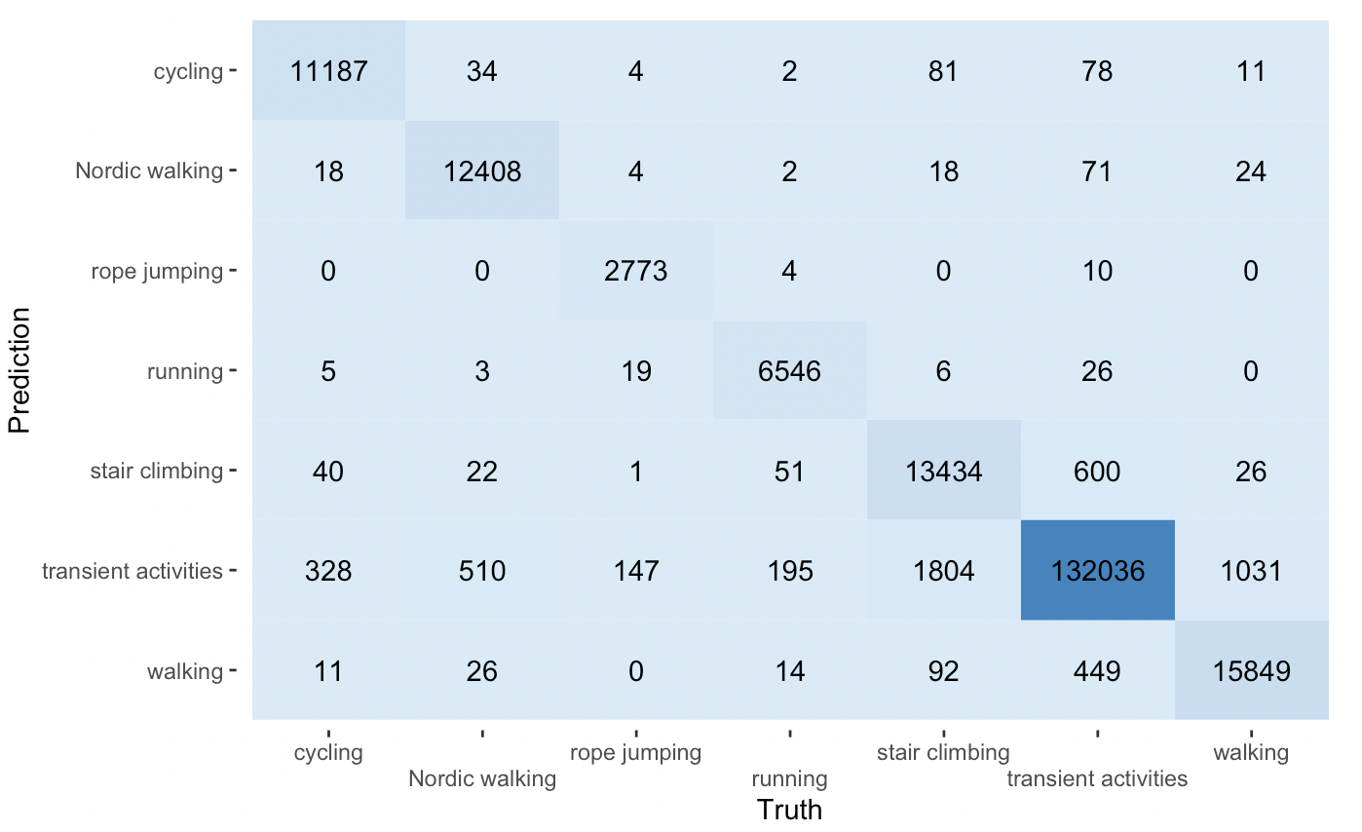
Results - chest

Slide 38
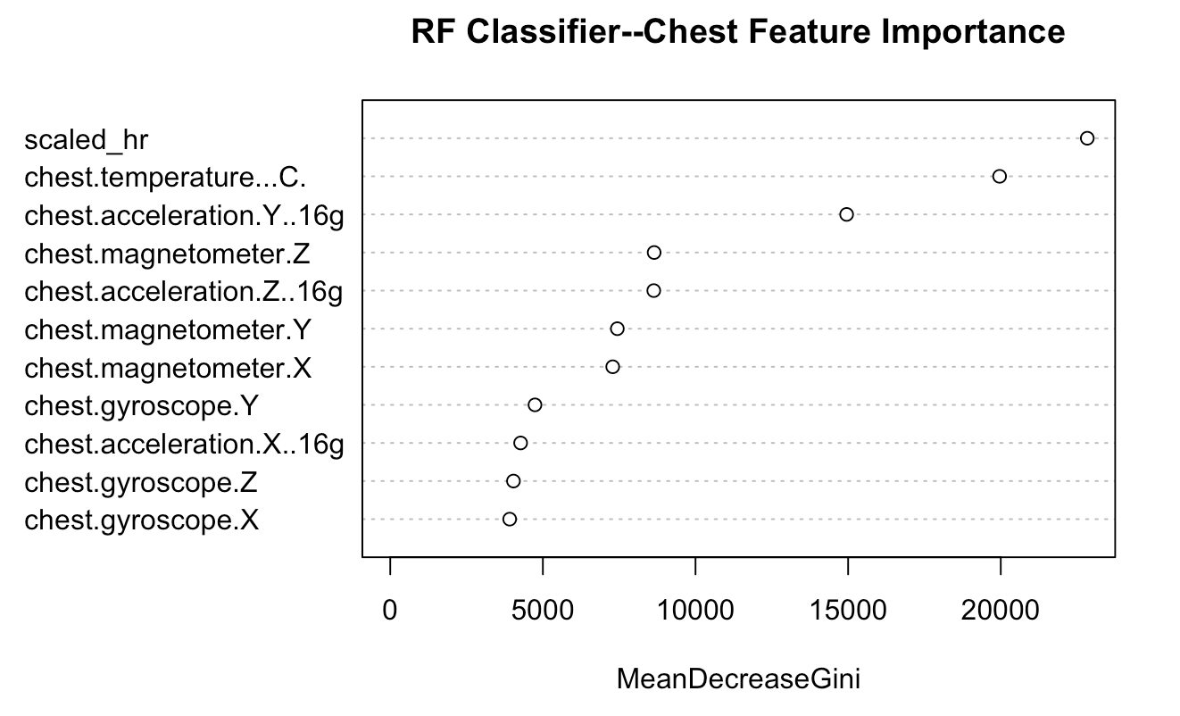

Slide 39
Conclusions and directions for further exploration
Random forest classifier performs very well on these data.
Further exploration of hyperparameter space is warranted (only used default mtry for example).
More activities for classification would be great! (WHOOP has 50+)
Applications beyond workout optimization such as public health (You’ve been lying down for 16 hours? Are you ok?).
Leverage time-series methods.
Imagine an algorithm that is biased towards predicting the average of previous n predictions (in time).

Slide 40

thank you!!

